Slide 1
RedOcean
Submitted To:-
Ms.Deeksha Verma
Submitted By:-
Sharanjeet Singh(1915122)
Diya Arora(1915346)

Slide 2
Introduction
Our project developing a Chatbot using sequence modelling focuses on developing a model which will be able to generate responses automatically to the questions asked using a number of different machine learning techniques. This document gives an introduction to the basic aspects of the proposed model. The proposed model may be used for order generating in restaurants or in call centre to deal with the common problems faced.
We are pursuing our objective in three phases: Design, analysis and Implementation. For analysis page we have taken a large segment of data from social networking sites to generate the outcomes for commonly discussed problems. The parameters are prioritized based on the interpretation of this data. We have also planned to include algorithms to differentiate the data according to whether we can generate answer for that or we need to use the internet in the types of questions asked. The UI is also pursued from analysis point of view.

Slide 3
Scope of The Project
A chatbot (also known as a talkbots, chatterbot, Bot, IM bot, interactive agent, or Artificial Conversational Entity) is a computer program or an artificial intelligence which conducts a conversation via auditory or textual methods.
In today’s world , as every one is disturbed by the mental stress and work load and in this situation everyone deserves a friend however many of us would not be able to get them so our bot will be a hope to those users and will act as a friendly bot where people can save or shre their feelings while still being isolated from world and too without being judged.

Slide 4
Features
Accuracy of Work
Friendly Bot
Able to run Python code
Able to Access Terminal Directly
Chats Would be save
Elascticity

Slide 5
Software Requirements
Python (Flask):- A web framework is a software architecture that contains tools and libraries used to develop a web application in a fast and efficient way. Flask is a microframework written in Python.
Twillo:-
Twilio powers personalized interactions and trusted global communications to connect you with customers.
NGROK:-
Wolfram-Alpha API

Slide 6
Library Requirements
certifi==2019.9.11
chardet==3.0.4
Click==7.0
Flask==1.1.1
idna==2.8
itsdangerous==1.1.0

Slide 7
Library Requirements
Jinja2==2.10.3
MarkupSafe==1.1.1
PyJWT==1.7.1
pytz==2019.3
requests==2.22.0
six==1.13.0
twilio==6.33.1
urllib3==1.25.7

Slide 8
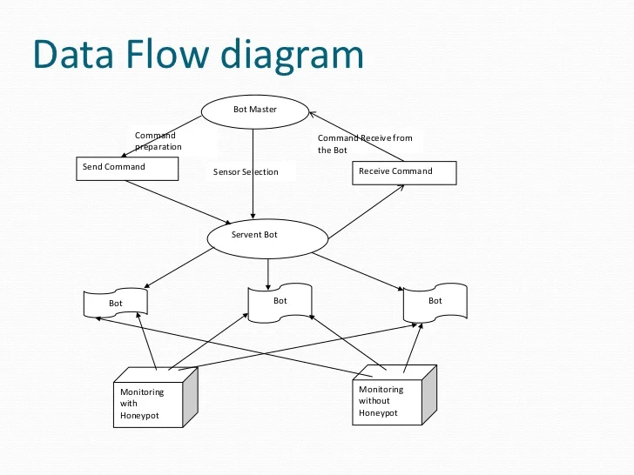
DFD Diagram

Slide 9
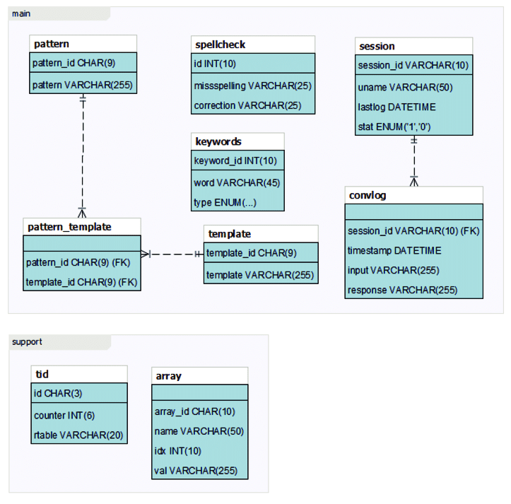
ERP DIAGRAM

Slide 10
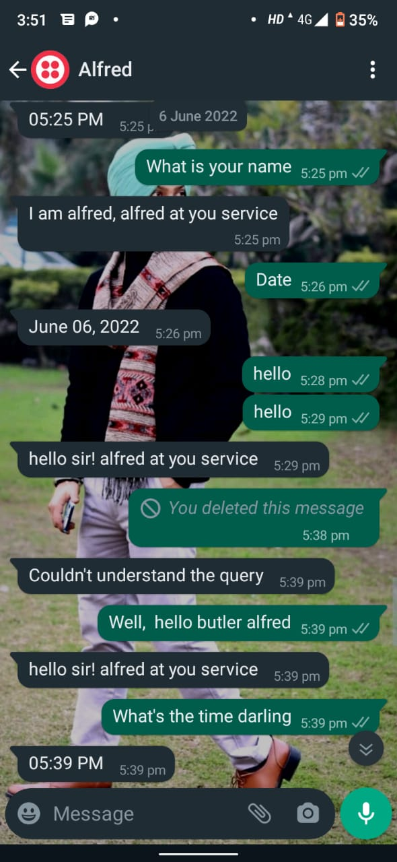
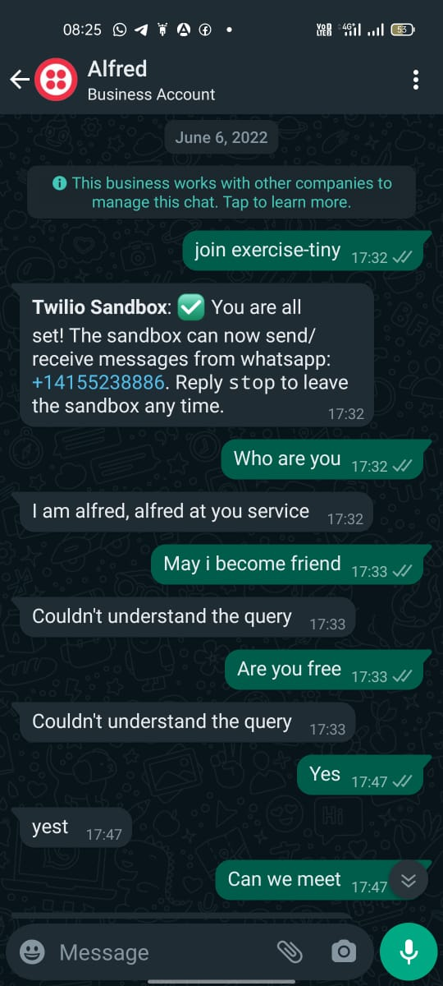
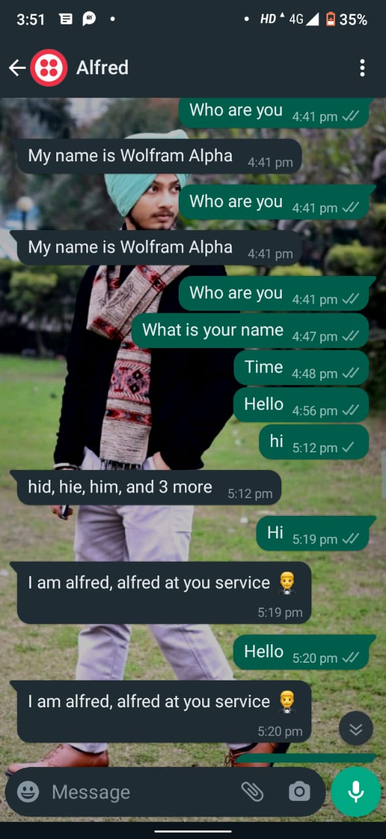
Output Screenshots

Slide 11
Output Screenshots

Slide 12


